Slide 1


Netflix shows recommendation system

Slide 2

Group Name – Group 1
Group Members:
Ritu Vinodbhai Kumbhani - C0865677
Harshil Mukesh Bhavsar - C0863170
Jeet Dhaneshkumar Patel - C0868588
Shivam Arvindbhai Machhi - C0871186
Dhru Prajapati - C0867085

Slide 3

Introduction
Netflix is a popular streaming service that provides users with a vast library of shows and movies. With so many options available, it can be overwhelming for users to decide what to watch next. To solve this problem, Netflix has developed a recommendation system using LDA, or Latent Dirichlet Allocation.
LDA is a machine learning algorithm commonly used in natural language processing. It works by identifying topics within a large set of documents and then assigning probabilities to each topic based on the words contained within each document. This allows the system to make recommendations based on user preferences and viewing history.

Slide 4

Dataset
We have used TMDB API to extract the dataset from tmdb.
At first, we created the account on TMDB and got the access to the API. Then we used Postman to run the query to get the data. So, we have used the below URL in Postman to extract the TMDB Netflix shows data.
https://api.themoviedb.org/3/discover/tv?api_key=deb585dfabf43c69bd9e46ba9b30b099&language=enUS&sort_by=popularity.desc&include_adult=false&include_video=false&with_watch_providers=Netflix&watch_region=CA&with_watch_monetization_types=flatrate
We extracted the data in a json format using python requests module by using above API urls, now we had to convert the data into Excel format so that we can use that in python to complete our project.
At last, we have created a python script to get the json data into Excel file.

Slide 5
Dataset contains around 14705 records and around 13 columns. Please find below the column information:
backdrop_path: The file path for the backdrop image of the movie or TV show.
first_air_date: The release date of the first episode of the TV show.
genre_ids: The genre IDs associated with the movie or TV show.
id: The unique identifier for the movie or TV show.
name: The name of the TV show.
origin_country: The country of origin for the TV show.
original_language: The original language of the movie or TV show.
original_name: The original name of the TV show.
overview: A brief description of the movie or TV show.
popularity: A numerical value that represents the popularity of the movie or TV show.
poster_path: The file path for the poster image of the movie or TV show.
vote_average: The average rating given to the movie or TV show.
vote_count: The number of ratings given to the movie or TV show.
text: This column is not a part of the original dataset and might have been created for some analysis or processing.

Slide 6

Preprocessing the Data
Initially, to categorize the data in our dataset, we used the genre id associated with each entry.
However, to make the information more accessible and user-friendly, we decided to replace the genre ids with the corresponding genre names.
To do this, we first cleaned the data by replacing all empty or whitespace-only strings with NaN values.
Then, we mapped the genre_ids to the appropriate genre names and updated the dataset accordingly.
This allowed us to present the information in a more organized and readable format.
We also removed duplicate values from our dataset and after removing those we had around 3000 records.

Slide 7
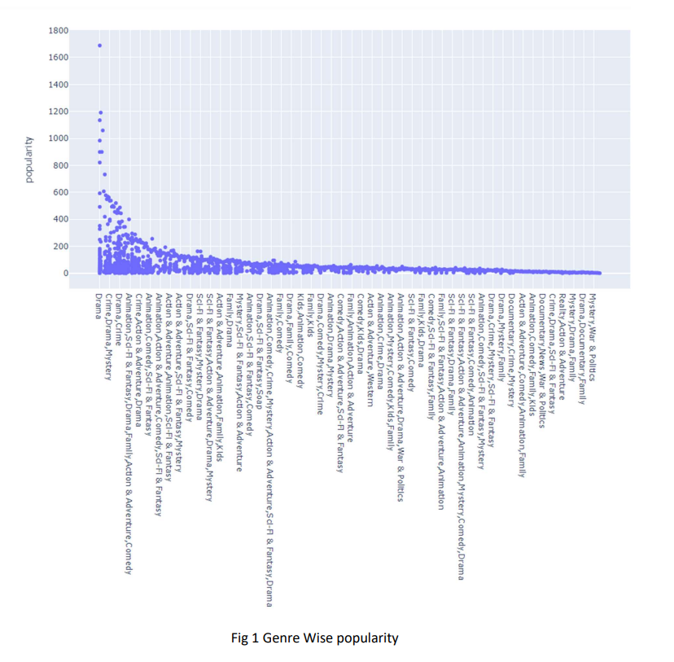
Data Visualization

Slide 8
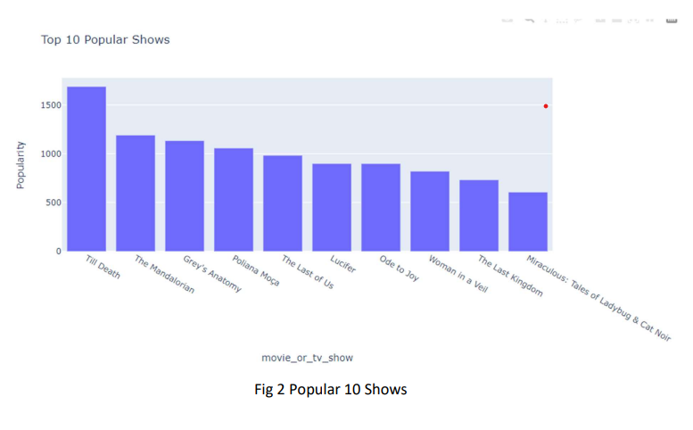
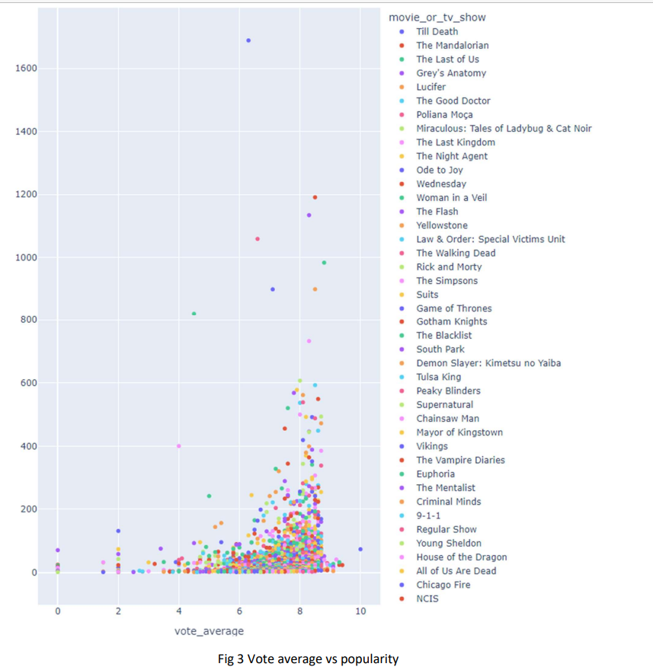

Slide 9

Model Building :
we vectorized the text data using tf-idf.
Then, we checked for cosine similarity.
Cosine similarity is a widely used technique in NLP for applications such as document clustering, document classification, and information retrieval. It is beneficial when dealing with large volumes of text data, as it can quickly identify similar documents without the need for expensive pairwise comparisons.
Here's a general overview of how cosine similarity can be used in NLP:
Vectorize the text data using a method like TF-IDF or CountVectorizer. This will convert each document into a vector of term frequencies.
Calculate the cosine similarity between each pair of documents using the formula: ➢ cosine_milarity(d1, d2) = dot_product(d1, d2) / (||d1|| * ||d2||) where d1 and d2 are the vectors representing the two documents

Slide 10
Understanding LDA Model
LDA (Latent Dirichlet Allocation) is a topic modeling technique that helps to discover hidden topics within a large volume of text data. It works by identifying patterns in the words used in the text and grouping them into topics. These topics are then used to categorize the text into relevant groups.
In the context of building a recommendation system for Netflix, we can use LDA to identify the topics that are most relevant to a user based on their viewing history. By analyzing the topics of the shows they have watched, we can recommend other shows that fall under the same category.

Slide 11
We have used below parameters in LDA.
num_topics = 10: This sets the number of topics that we want to extract from the text data.
After fitting the LDA model, you can use the lda object to extract the most representative words for each topic, as well as the topic distribution for each document in the corpus.
This can help you identify the main themes and topics that are present in the text data, and can be useful for tasks like document clustering, topic labeling, and content recommendation.

Slide 12

Then, we developed a Python function that recommends movies based on a user's input movie title.
In the function, initially, we get the index of the shows. Then, Get the cosine similarities for the shows, After that, we Sort the cosine scores in descending order and Get the indices of the top movies to print in a data frame.
At last, we have developed a table with the top 10 results of some particular shows.

Slide 13
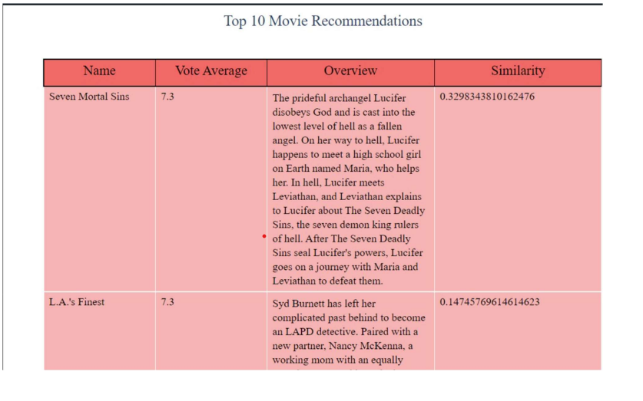
we have developed a table with the top 10 results of some particular shows.

Slide 14
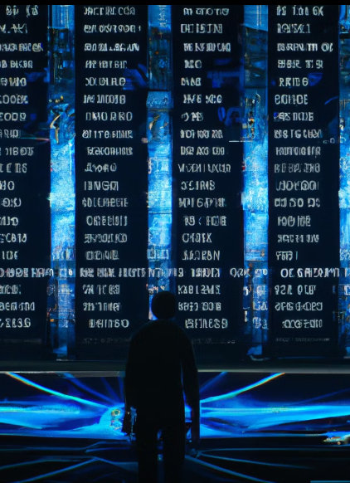
Conclusion
To conclude, we can see that we have received around 60% of similarities for some shows recommendations. But for some shows we have received very less accuracy.
By analyzing the overall project, we found that, as we scraped the data from tmdb there may be a chance that some data are not related to other shows that we have in our dataset so that’s why we are getting less accuracy for some of the show's recommendation.

Slide 15
References:
[1] Prabhakaran, S. (2018, October 22). Cosine Similarity – Understanding the math and how it works (with python codes). Machine Learning Plus. https://www.machinelearningplus.com/nlp/cosine-similarity/
[2] GOYAL, C. (2021, June 28). Part 18: Step by Step Guide to Master NLP - Topic Modelling using LDA (Probabilistic Approach). Analytics Vidhya. https://www.analyticsvidhya.com/blog/2021/06/part-18-step-by-step-guide-to-master-nlp-topic-modelling-using-lda-probabilistic-approach/
[3] TMDB API - https://developers.themoviedb.org/3/getting-started/introduction
[4] Plotly Express. (n.d.).Plotly.com. https://plotly.com/python/plotly-express/

Slide 16
Thankyou!!
Any Questions?

